Slide 1
Deferred Programming
jQuery

Slide 2
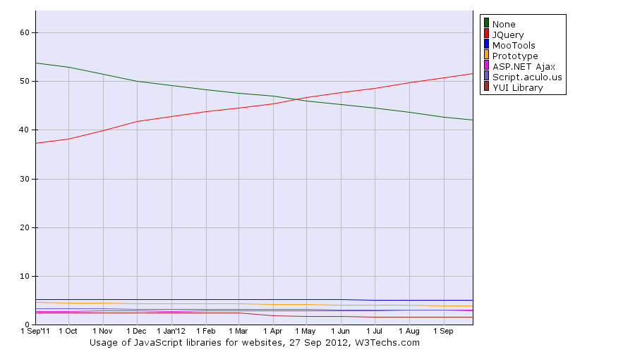
Why jQuery?

Slide 3
What is Deferred Programming?
A method for asynchronous logic encapsulation
Based on CommonJS Promises/A design
A promise represents the eventual value returned from the single completion of an operation. A promise may be in one of the three states, unfulfilled, fulfilled, and failed*. The promise may only move from unfulfilled to fulfilled, or unfulfilled to failed. Once a promise is fulfilled or failed, the promise's value MUST not be changed.
*jQuery uses pending, resolved, and rejected

Slide 4
Why use it?
Readability - Getting closer to self documenting code
Encapsulation - Keep the logic separate. Let the Deferred method worry about error codes and implementation.
Any asynchronous process
AJAX
User interactions (more on this later)
Previously, you’d do something like this:
var xhr = new XMLHttpRequest(); xhr.open('GET', 'url', true); xhr.addEventListener( 'load', function() { if (xhr.status === 200) { alert("We got data: " + xhr.response); } } ); xhr.send();

Slide 5
Let jQuery do it
Let jQuery handle most of the leg work (extend it’s functionality)
jQuery AJAX calls return a jQuery.Deferred().promise() object
Since jQuery 1.5
It’s now as easy as:
jQuery.get ( someURL ).done ( function(data) { /* success */ } ).fail ( function(message) { /* fail */ } );

Slide 6
jQuery.Deferred().promise()?
A promise object is an object that “promises” to do some work, wait for the appropriate responses, and call all applicable callbacks.
It’s non-blocking.
It encapsulates the event calls, listeners, and event specific codes so you don’t have to deal with them in your logic.

Slide 7
How jQuery makes this better
jQuery adds the ability to wait for several promises to complete and adds progress/notify (jQuery 1.7) functionality
jQuery.when ()
jQuery.when ( jQuery.ajax(url1), jQuery.ajax(url2), jQuery.ajax(url3) ).done ( /* success */ ).fail ( /* fail */ );

Slide 8
Progress and notify
jQuery.when ( /* promise(s) */ ).progress ( function (message) { /* update UI here? */ } );
Live Example: http://jsfiddle.net/bSPb9/

Slide 9
Chainable
jQuery.ajax( someURL ) .done ( processSomething ) .done ( processSomethingElse )

Slide 10
Roll your own…
function waitForUserToPressNext() { return jQuery.Deferred( function(defer) { jQuery('body').keyup( function(event) { if (event.keyCode === 39) { defer.resolve('key'); } } ); jQuery('#nextButton').click( function(event) { defer.resolve('button'); } ); } ).promise(); } waitForUserToPressNext().then( function(how) { console.log('done! ' + how); } );
Live Example: http://jsfiddle.net/4bGbU/

Slide 11
Other Notable Features
deferred.always()
Executes a callback on success or fail
deferred.notifyWith()
Allows you to specify a context with the notification (What scope 'this' will represent)
notifyWith(context [, message])
deferred.pipe()
Allows you to redirect success, fail, or progress notifications for further processing
API Wrapping: Your web server returns 200 OK for all requests. This will go to your success handler even if the API intends for it to be a failure. If you pipe the deferred object, you can override it with further logic and return a new Deferred object in a rejected state.
Filtering: The pipe can alter the resolve/fail/progress data that is sent to your callbacks. This can be handy for filtering out or adding in data that is needed in the callback.
Formatting: Alter the return data by applying a format.
deferred.reject()
Not shown in previous slides, but this is what is called to fail a promise.
deferred.rejectWith()
Same concept as notifyWith() above for rejecting with scope
deferred.resolveWith()
Same concept as notifyWith() above for succeeding with scope
deferred.state()
Get the state of the promise
deferred.then()
Allows you to specify success, fail, and progress callbacks with one call
defer.then(successCallback, failCallback, progressCallback)

Slide 12
Links
http://api.jquery.com/category/deferred-object/
http://w3techs.com/technologies/history_overview/javascript_library/all

